Slide 1
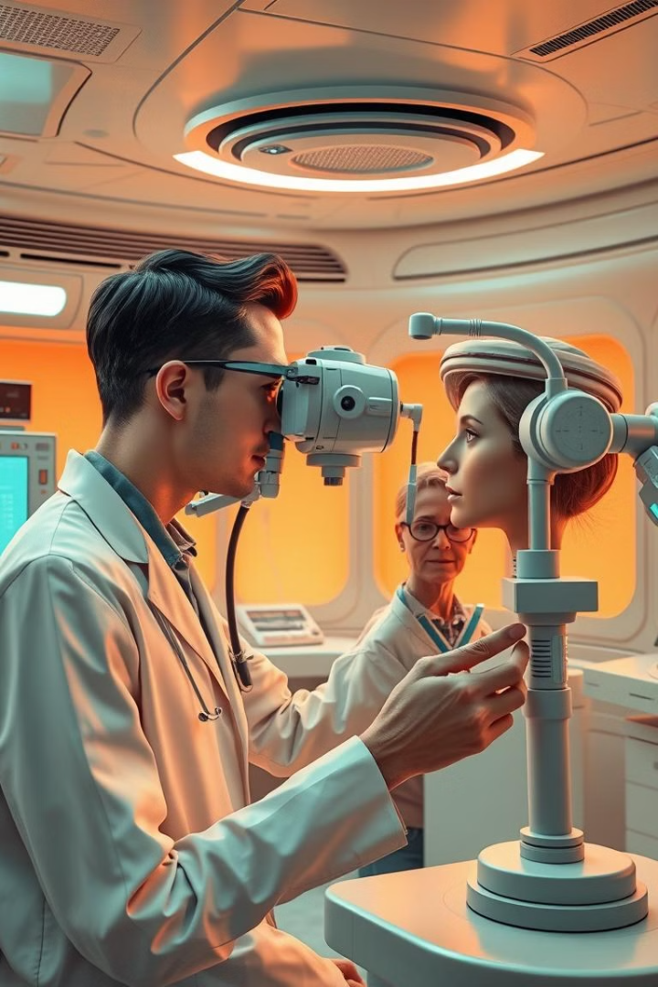
Eye Disease Prediction System
Welcome to our presentation on the Eye Disease Prediction System, a hybrid approach for early detection of glaucoma, cataracts, and diabetic retinopathy. Our project seeks to address the challenges in accessing specialized ophthalmic care and provide accessible and accurate diagnosis using advanced machine learning techniques.

Slide 2

Team Members
Kukutla Manohar
21BCE9466
Scope
BALLARI MALIK BASHA
21BCE9545
Scope
K.NAVANEESWAR GOWD
21BCE9486
Scope
G.SUNDHAR CHAITANYA
21BCE9746
Scope

Slide 3
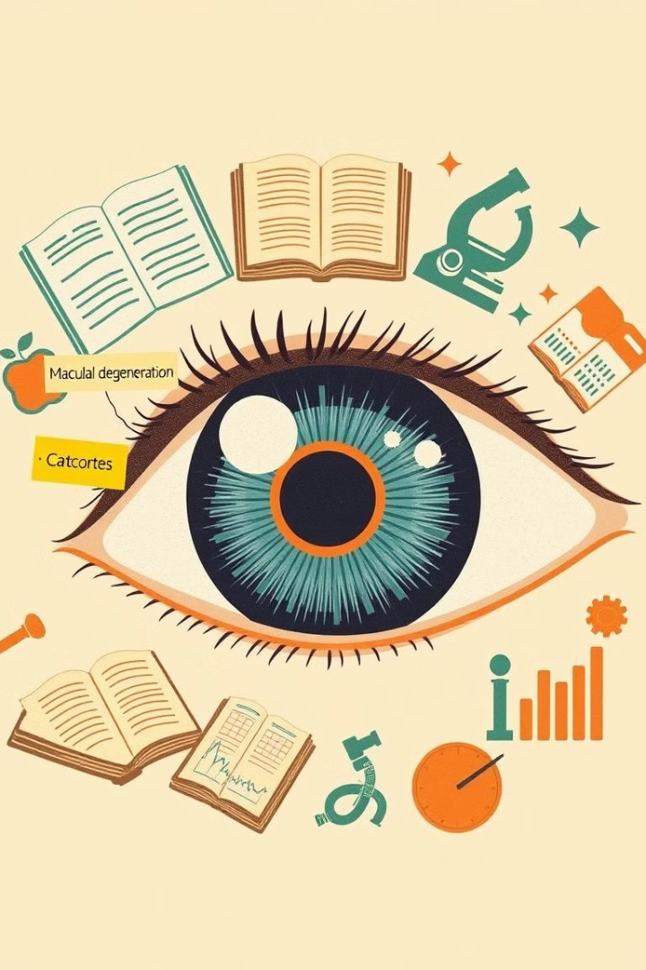
Disease
Glaucoma
Cataract Detection
Glaucoma is a group of eye conditions that damage the optic nerve, usually due to high pressure inside the eye. It is a leading cause of blindness if untreated, but early detection and treatment can prevent vision loss.
Cataract is a condition where the lens of the eye becomes cloudy, leading to vision problems. It is a common cause of vision impairment, especially in older adults, but it can be treated effectively with surgery.
Blurry or cloudy vision.
Sensitivity to light and glare.
Difficulty seeing at night.
Fading or yellowing of colors.
Severe eye pain.
Blurred vision or halos around lights.
Nausea and vomiting.
Sudden vision loss.
Diabetic Retinopathy Detection
Diabetic Retinopathy (DR) is a diabetes-related eye condition that damages the retina's blood vessels, leading to vision problems and potentially blindness if untreated. Early detection is crucial to prevent severe outcomes.
Dark spots or floaters.
Difficulty seeing at night.
Vision loss.

Slide 4
Introduction
Problem Statement
Our Solution
Eye diseases like glaucoma, cataracts, and diabetic retinopathy affect millions worldwide. Early detection is crucial to prevent vision loss, but access to ophthalmic care is limited, especially in underserved regions. This gap in care highlights the need for innovative solutions.
Our system leverages Convolutional Neural Networks (CNNs) and machine learning to analyze retinal images and predict the presence of these diseases. By automating diagnosis, we aim to enhance accessibility and expedite treatment.

Slide 5
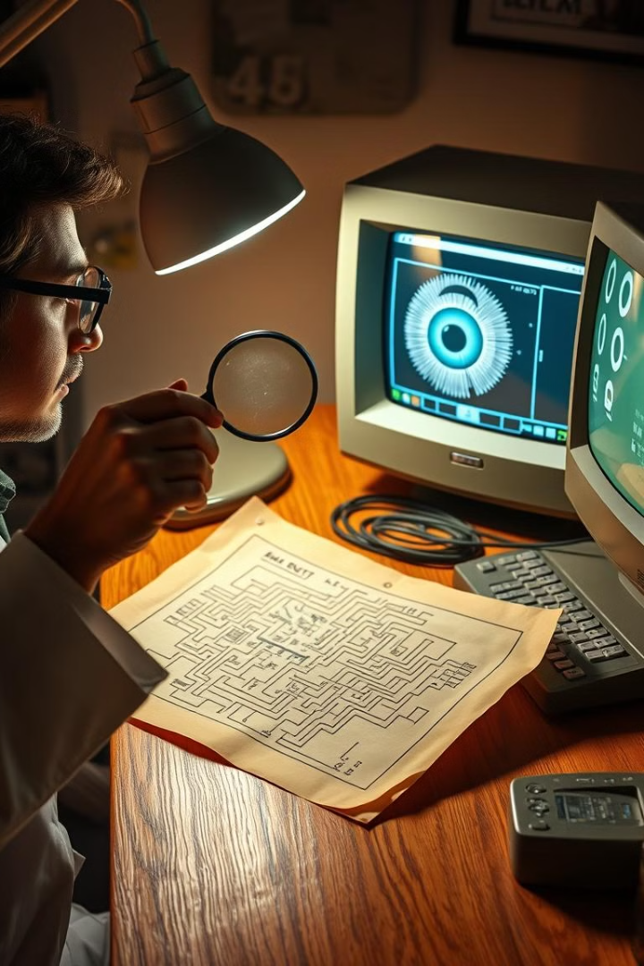
Objectives
1
Early Detection
2
Hybrid Deep Learning
Enable timely detection of glaucoma, cataracts, and diabetic retinopathy, empowering patients to seek early treatment.
Utilize deep learning models like CNNs and Vision Transformers, combined with traditional machine learning techniques to enhance accuracy.
3
Patient-Centric Approach
Develop a user-friendly platform for healthcare providers and patients to access results, facilitating communication and understanding.

Slide 6
Working Methodology
Model Selection and Training
Data Collection
We employ a diverse set of models, including CNNs like ResNet50 and VGG-16, Vision Transformers, and Random Forest, evaluating their performance on different datasets and selecting the most effective model for each eye disease.
Our system utilizes a multi-faceted approach, incorporating retinal images, genetic data, and patient medical history, providing comprehensive data for accurate analysis.
1
2
3
4
Preprocessing and Feature Extraction
User Interface
Image preprocessing involves cleaning, filtering, and normalizing retinal images to enhance feature extraction, while medical and genetic data is transformed for compatibility with machine learning models.
A user-friendly web interface and patient dashboard provide easy access to results, enabling healthcare providers and patients to readily understand the diagnosis and treatment recommendations.

Slide 7
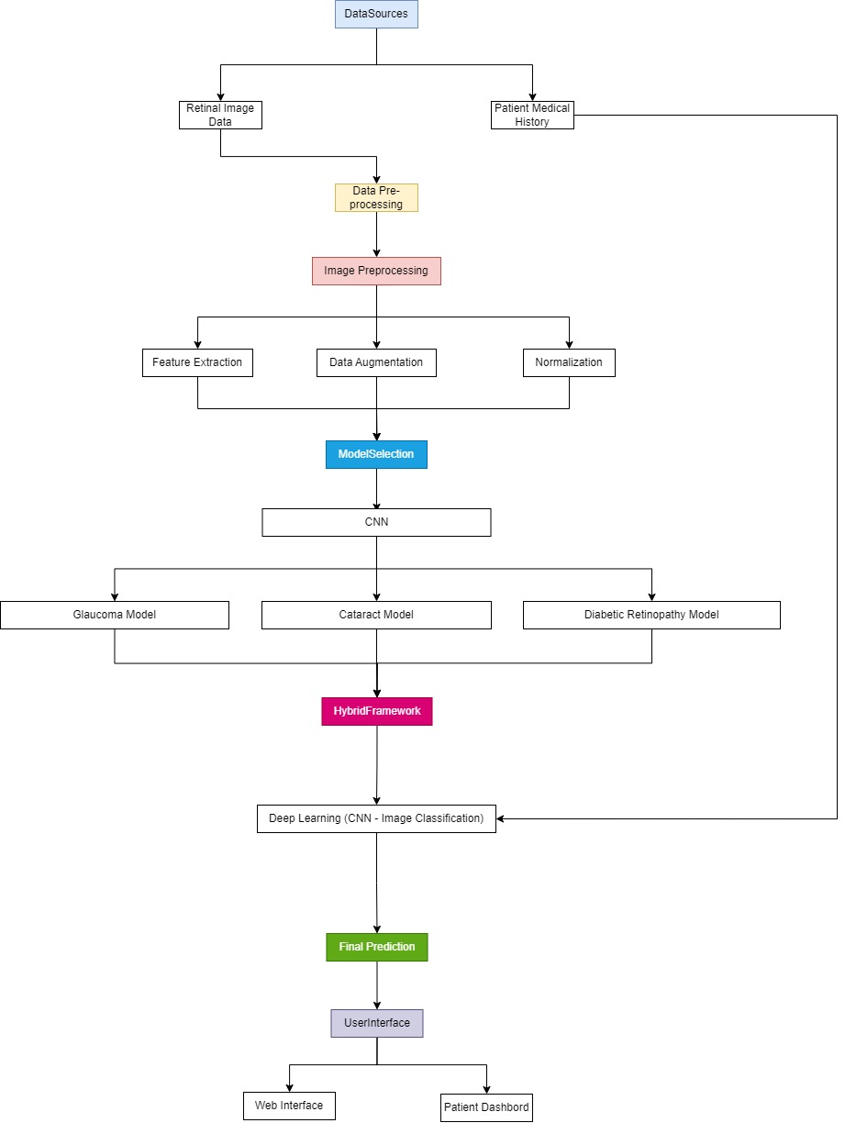
Flow Chart

Slide 8
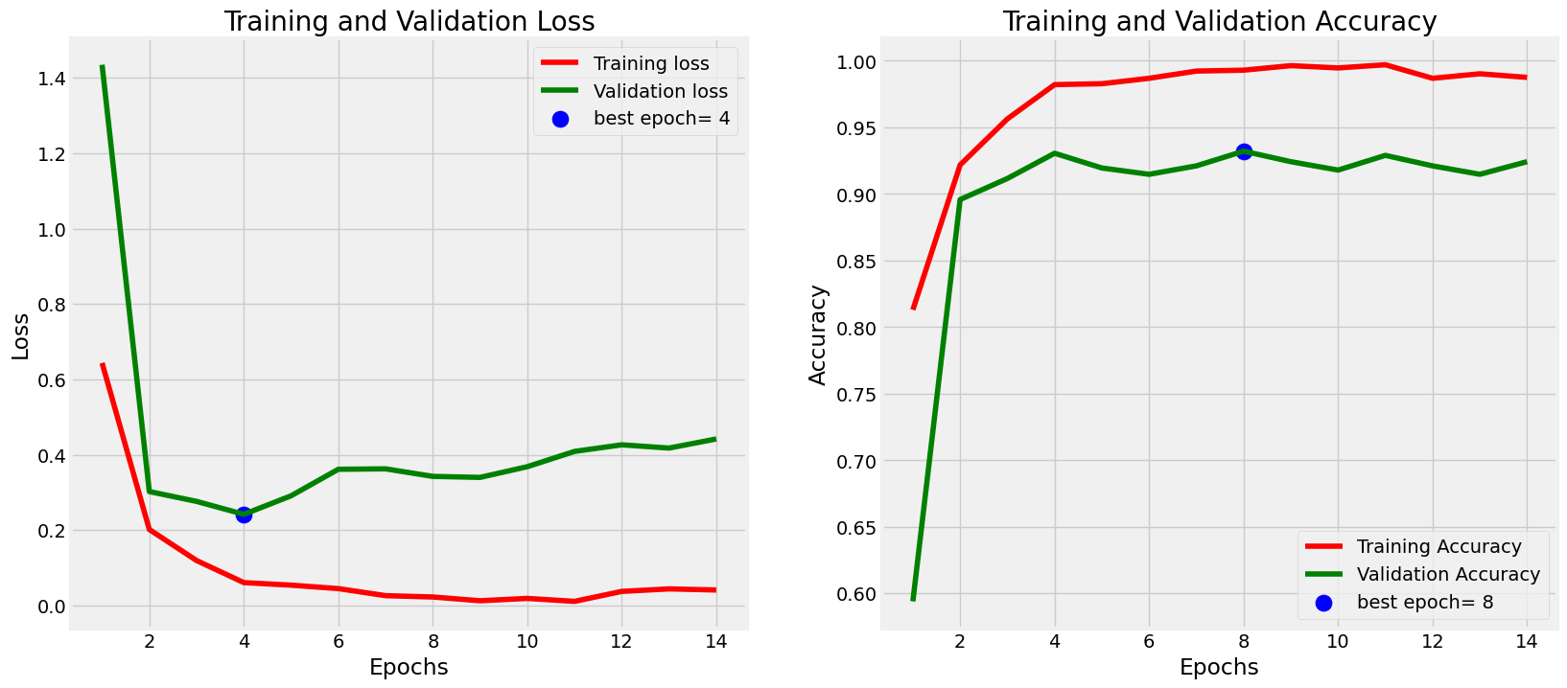




Results and Discussions
Model Accuracy
Generalizability
Our system consistently achieves high accuracy in detecting various eye diseases, demonstrating its potential for reliable diagnosis.
The models demonstrate excellent generalizability across diverse retinal datasets, showcasing their ability to accurately diagnose patients with various backgrounds and eye conditions.
Efficiency
Challenges
The system excels in processing images and generating results in a timely manner, enabling rapid diagnosis and prompt treatment.
We have encountered challenges related to data limitations, computational complexity, and interpretability, areas that require ongoing research and improvement.

Slide 9


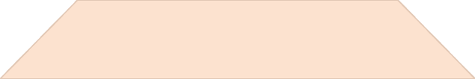
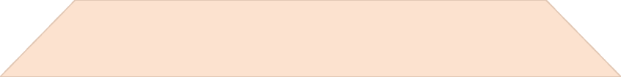
Conclusion
1
Impact
2
Efficiency
3
Accuracy
4
Accessibility
Our Eye Disease Prediction System provides a reliable, efficient, and scalable solution for early eye disease detection. This system has the potential to significantly impact eye care, particularly in underserved regions, by providing access to accurate and timely diagnoses, empowering individuals to take control of their eye health.

Slide 10


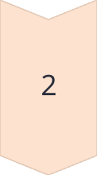
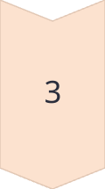

Future Work
Dataset Expansion
We plan to further expand our dataset by incorporating diverse demographic data and including a wider range of eye diseases, strengthening the model's ability to handle diverse patient populations.
Real-World Testing
Our next step is to conduct extensive real-world testing in clinical settings to validate the system's performance in practical scenarios and gather feedback from healthcare professionals.
Model Interpretability
We aim to improve model interpretability by employing explainable AI techniques, making the diagnostic process more transparent and understandable for both healthcare providers and patients.
Optimization
We plan to develop lightweight versions of the model for real-time deployment in resource-limited environments, ensuring accessibility for all.

Slide 11

References
• Deep Learning for Medical Image Analysis Litjens, G., Kooi, T., Bejnordi, B. E., et al. "A survey on deep learning in medical image analysis." Medical Image Analysis, 42, 60-88, 2017. Link
• Glaucoma Detection Using Convolutional Neural Networks Medeiros, F. A., & Weinreb, R. N. "Artificial intelligence in glaucoma: Big data and machine learning." Current Opinion in Ophthalmology, 29(2), 141-146, 2018. Link
• Applications of Vision Transformers in Image Analysis Dosovitskiy, A., Beyer, L., Kolesnikov, A., et al. "An image is worth 16x16 words: Transformers for image recognition at scale." arXiv preprint arXiv:2010.11929, 2020. Link
• Diabetic Retinopathy Detection Using CNNs Gulshan, V., Peng, L., Coram, M., et al. "Development and validation of a deep learning algorithm for detection of diabetic retinopathy in retinal fundus photographs." JAMA, 316(22), 2402-2410, 2016. Link

Slide 12


